Slide 1
Capstone Project- 2
Supervised ML-Regression
(Bike Sharing Demand Prediction)
By Team GodSpeed
Members:
Akash Jaiswal
Jagdish Mahato
Abhishek Rana
Kanika Raj

Slide 2
CONTENT
❏ BUSINESS UNDERSTANDING
❏ DATA SUMMARY
❏ FEATURE ANALYSIS
❏ EXPLORATORY DATA ANALYSIS
❏ DATA PREPROCESSING
❏ IMPLEMENTING ALGORITHMS
❏ CHALLENGES
❏ CONCLUSIONS

Slide 3
BUSINESS UNDERSTANDING
Bike rentals have became a popular service in recent years and it seems people are using it more often. With relatively cheaper rates and ease of pick up and drop at own convenience is what making this business thrive.
Mostly used by people having no personal vehicles and also to avoid congested public transport which that’s why they prefer rental bikes.
Therefore, the business to strive and proﬁt more, it has to be always ready and supply no. of bikes at different locations, to fulﬁl the demand.
Our project goal is a pre planned set of bike count values that can be a handy solution to meet all demands.

Slide 4
Problem Statement
Currently Rental bikes are introduced in many urban cities for the enhancement of mobility comfort. It is important to make the rental bike available and accessible to the public at the right time as it lessens the waiting time. Eventually, providing the city with a stable supply of rental bikes becomes a major concern. The crucial part is the prediction of bike count required at each hour for the stable supply of rental bikes.

Slide 5
Data Pipeline
Exploratory Data Analysis (EDA): In this part we have done some EDA on the features to see the trend.
Data Processing: In this part we went through each attributes and encoded the categorical features.
Model Creation: Finally in this part we created the various models. And
These various models are being analysed and we tried to study various models to get the best performing model for our project.

Slide 6
Data Description :
Independent variables:
• Date : year-month-day
• Hour - Hour of the day
• Temperature-Temperature in Celsius
• Humidity - %
• Windspeed - m/s
• Visibility - 10 m
• Dew point temperature - Celsius
• Solar radiation - MJ/m2
• Rainfall - mm
• Snowfall - cm
• Seasons - Winter, Spring, Summer, Autumn
• Holiday - Holiday/No holiday
• Functional Day – No Func(Non Functional Hours), Fun(Functional hours)
Dependent variable:
• Rented Bike count - Count of bikes rented at each hour

Slide 7
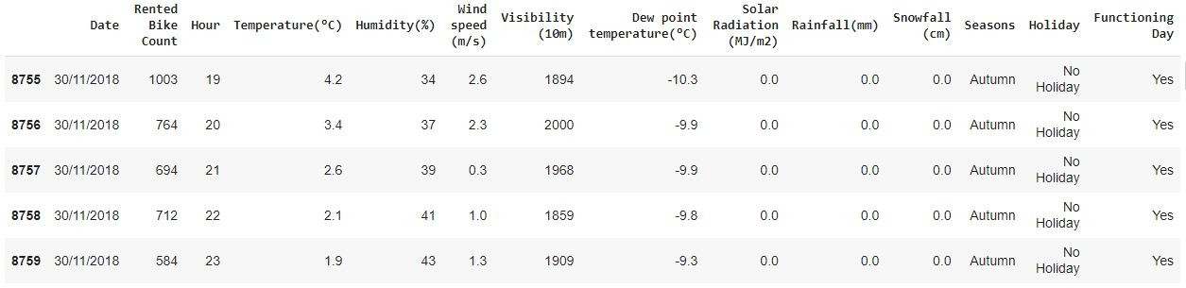
DATA SUMMARY
This Dataset contains 8760 lines and 14 columns.
Three categorical features ‘Seasons’, ‘Holiday’, & ‘Functioning Day’.
One Datetime features ‘Date’.
We have some numerical type variables such as temperature, humidity, wind, visibility, dew point temp, solar radiation, rainfall, snowfall which describe the environment conditions at that particular hour of the day.

Slide 8
INSIGHTS FROM OUR DATASET
There are No Missing,Duplicate and null Values present in the SeolBike Dataset.
And ﬁnally we have 'rented bike count' variable which we need to predict for new observations.
The dataset SeolBike shows hourly rental data for one year i.e. 1 decm2017 to 31 Nov 2018 (365 days).we consider this as a single year data.
So we convert the "date" col. into 3 different columns i.e. Year, month, day.
We change the name of some features for our convenience , they are as below:
'Rented_Bike_Count', 'Hour', 'Temperature', 'Humidity', 'Wind_speed', 'Visibility', ‘Dew_point_temperature', 'Solar_Radiation', 'Rainfall', 'Snowfall', 'Seasons', 'Holiday', 'Functioning_Day', 'month','weekdays_weekend'

Slide 9
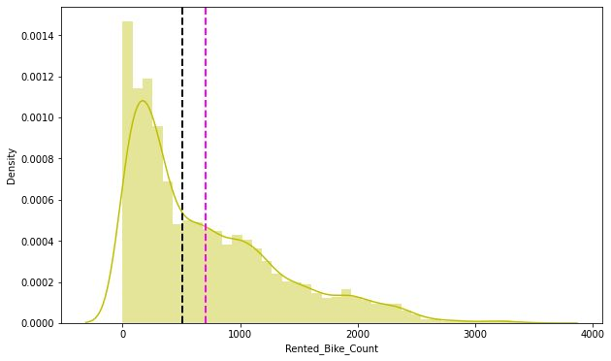
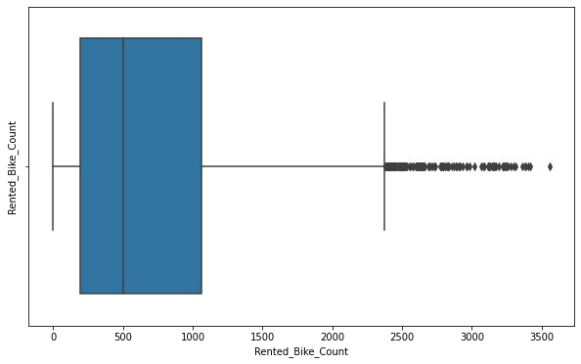
ANALYSIS OF RENTED BIKE COLUMN
The above graph shows that Rented Bike Count has moderate right skewness.
The above right side boxplot shows that we have detected outliers in Rented Bike Count column.
Since the assumption of linear regression is that 'the distribution of dependent variable has to be normal', so we should perform Square root operation to make it normal.

Slide 10
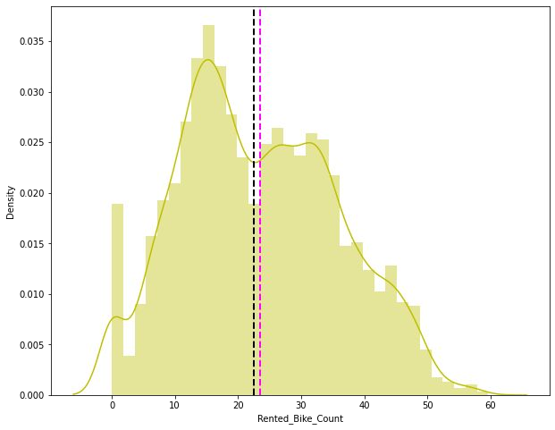
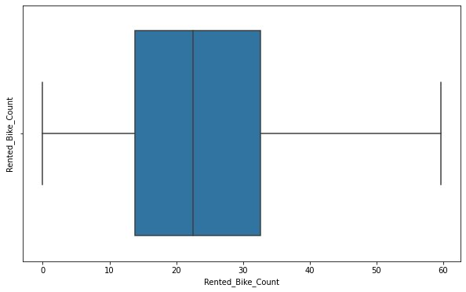
ANALYSIS OF RENTED BIKE COLUMN
As we can see in histogram graph, after applying Square root to skewed Rented Bike Count, we get almost normal distribution.
After applying Square root operation there are no outliers present in the Rented Bike Count column as shown above in right side box plot .

Slide 11
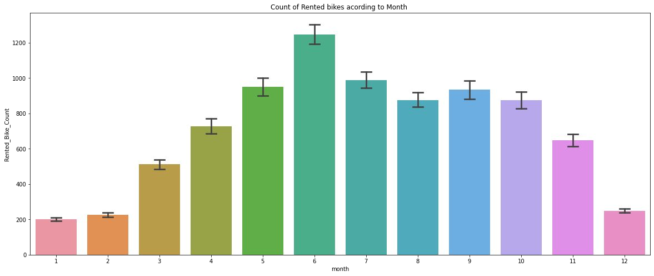
ANALYSIS OF MONTH VARIABLE
From the above bar plot we can clearly show that the demand of the rented bike is high from 5th to 10th month as compare to other months and these months represents summer season.

Slide 12
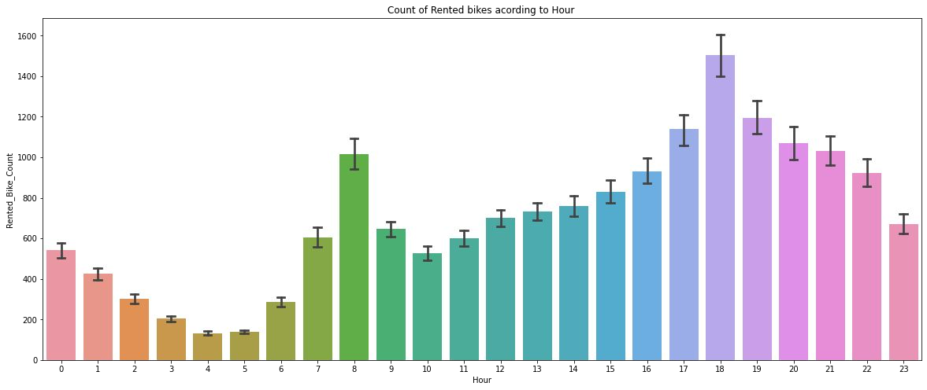
ANALYSIS OF HOUR VARIABLE
Above barplot describing the use of rented bike count according to the 'hour‘ and the data shown for a year or 365 days.
It is clear from the graph that generally people use rented bikes during their working hour from 7am to 9am and 5pm to 7pm.

Slide 13
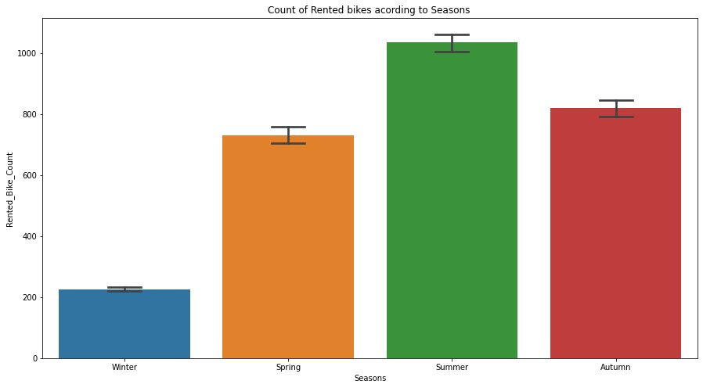
ANALYSIS OF SEASON VARIABLE
Above bar plot shows the distribution of rented bike count 'season' wise.
And we can clearly see that, most of the people prefer to ride bike in summer and autumn season.
Conversely 'winter season‘ has the least number of rented bikes and it may be because of heavy snowfall.

Slide 14
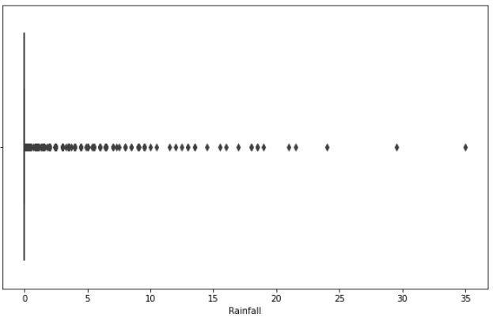
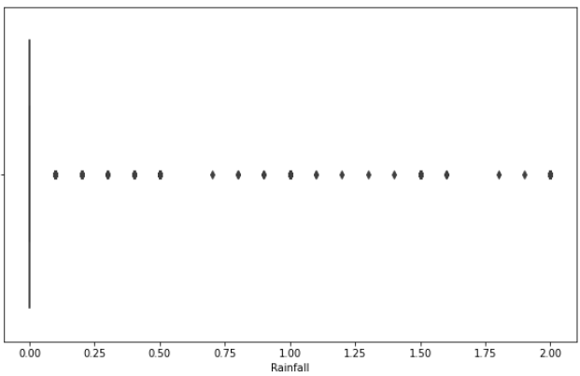
After Trimming
Detection and Treatment of outliers on numerical columns.
Trimming is one of a technique of treating outliers in which we trim the outliers equal to normal values of the column.
In this we can see that column ‘Rainfall’ has many outliers reaching maximum point of 35 but after trimming them we can see that the outliers maximum range is capped to 2.

Slide 15
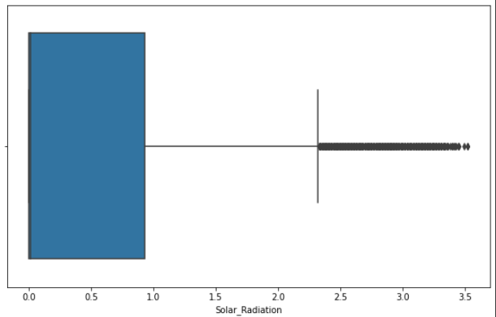
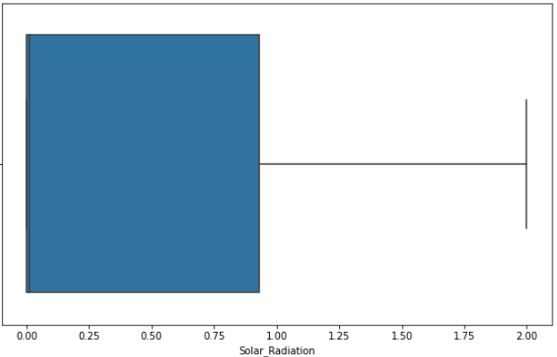
Detection and Treatment of outliers on numerical columns.
After Trimming
Trimming technique on ‘Solar radiation’ column.
In this we can see that column ‘solar radiation’ has many outliers reaching maximum point of 3.5 but after trimming them we can see that there are no more outliers.

Slide 16
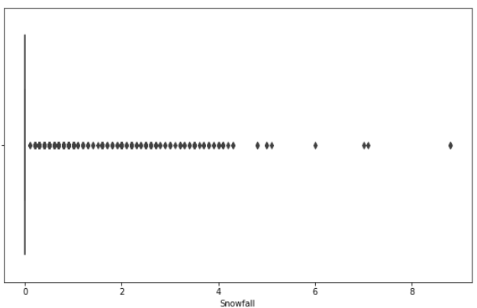
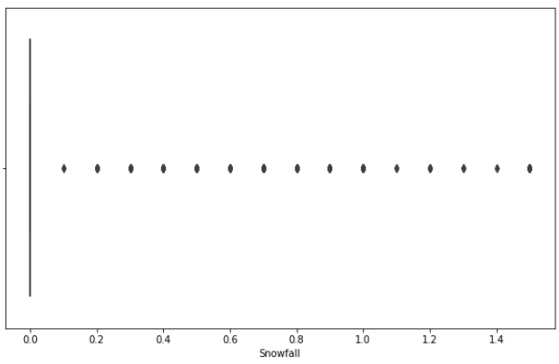
Detection and Treatment of outliers on numerical columns.
After Trimming
Trimming technique on ‘Snowfall’ column.
In this we can see that column ‘snowfall’ has many outliers reaching maximum point of 8.5 but after trimming them we can see that the outliers are now capped to 1.5.

Slide 17
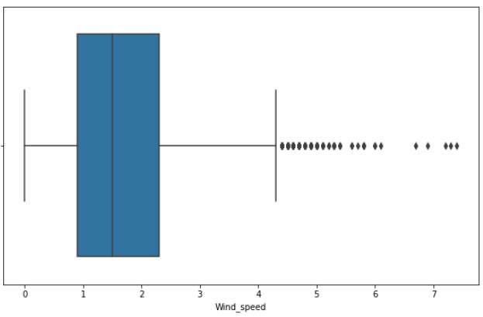
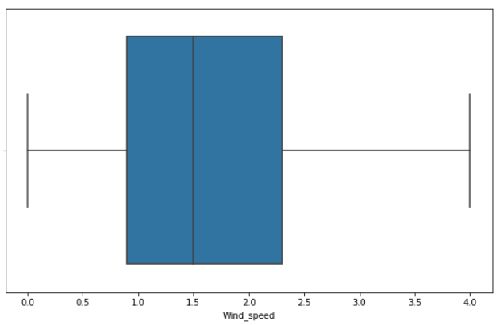
Detection and Treatment of outliers on numerical columns.
After Trimming
Trimming technique on ‘Wind_Speed’ column.
In this we can see that column ‘wind speed’ has many outliers reaching maximum point of 7.5 but after trimming them we can see that there are no more outliers.

Slide 18
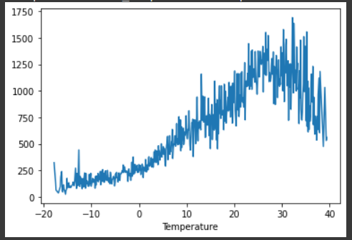
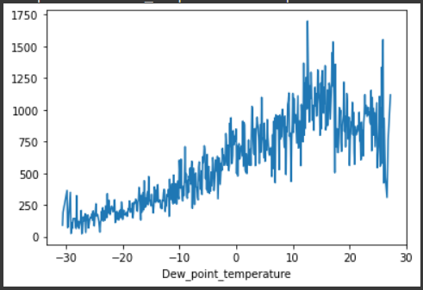
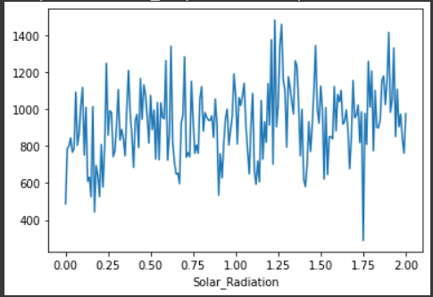
NUMERICAL VS.RENTED BIKE COUNT
Above plot is showing the comparison between ‘Temperature’, ‘Dew point temp.’ and solar radiation and it shows that people like to ride bikes when it is pretty hot around 25°C to 30°C in average.
Also "Dew_point_temperature' is almost same as the 'temperature' because of similar nature of data.
From the above graph we see that, the amount of rented bikes is huge when there is solar radiation, the count of rented bikes are around 1000.

Slide 19
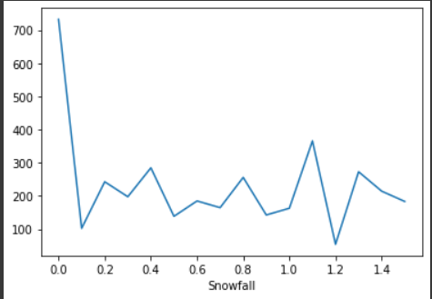
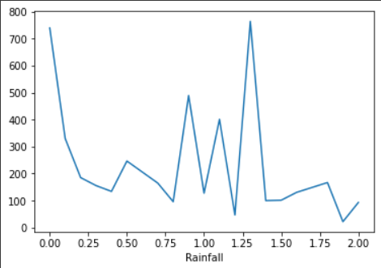
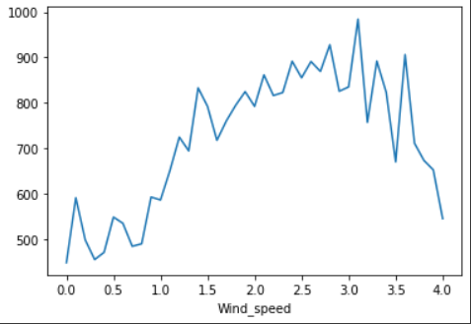
NUMERICAL VS.RENTED BIKE COUNT
The above Graph for ‘Snowfall’ represents that the amount of rented bike is very low and specially in 4cm range.
Above Graph for 'Rainfall‘ shows that in heavy rainfall the demand of rent bikes is not decreasing, here for example even if we have 20 mm of rain there is a big peak of rented bikes.
In 'wind_speed‘ Graph, the demand of rented bike is uniformly distributed but when the speed of wind is 7 m/s the demand of bike increases.

Slide 20
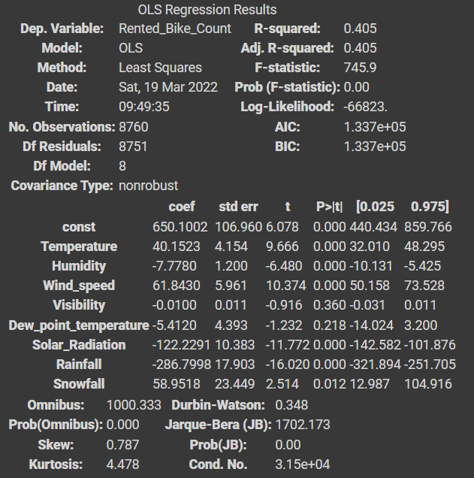
OLS REGRESSION MODEL
R square and Adj Square are near to each other. 40% of variance in the Rented Bike count is explained by the model.
P value of dew point temp and visibility are very high and they are not signiﬁcant.
OLS model shows that ‘visibility', 'snowfall’, and ‘Dew_point_temperature’ columns are not necessary for the model.

Slide 21
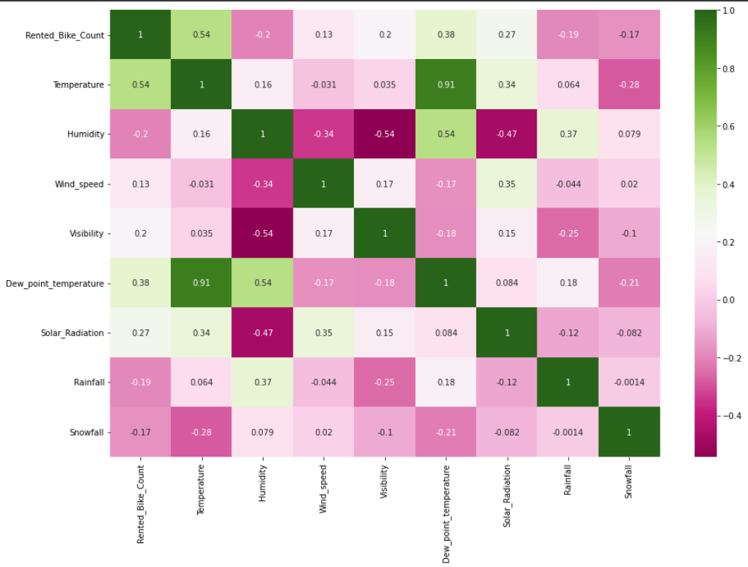
CORRELATION HEATMAP
Variables like Dew Point Temperature, and Temperature are highly correlated.

Slide 22
MODEL BUILDING
LINEAR REGRESSION
LASSO REGRESSION
RIDGE REGRESSION

Slide 23
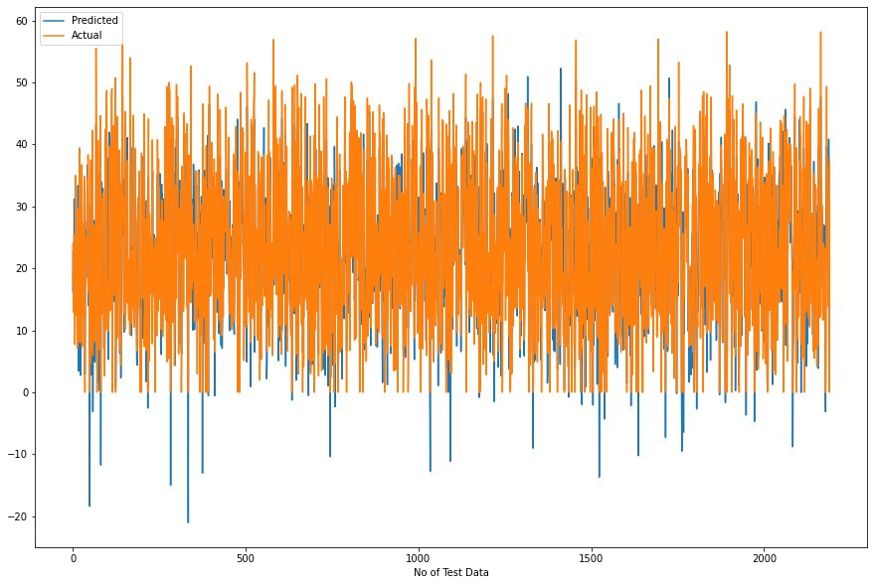
LINEAR REGRESSION
Train Set Results
Test Set Results

Slide 24
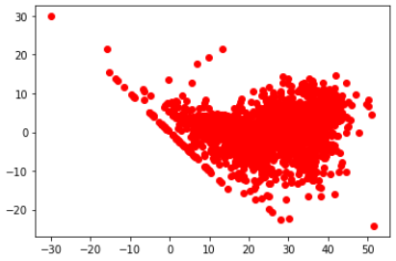
Heteroscedasticity
In this Linear regression model we can see that model is able to capture most of the data/variance and hence data is less and randomly scattered and errors are not forming any pattern.
So, this model is suitable for the given dataset.

Slide 25
LASSO REGRESSION
Train Set Results
Test Set Results

Slide 26
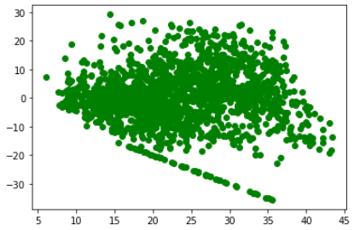
Heteroscedasticity
In this Regularized lasso regression model we can see that model is not able to capture most of the data/variance and hence data is more and randomly scattered and errors are trying to form a pattern.
So, this model is not suitable for this dataset.

Slide 27
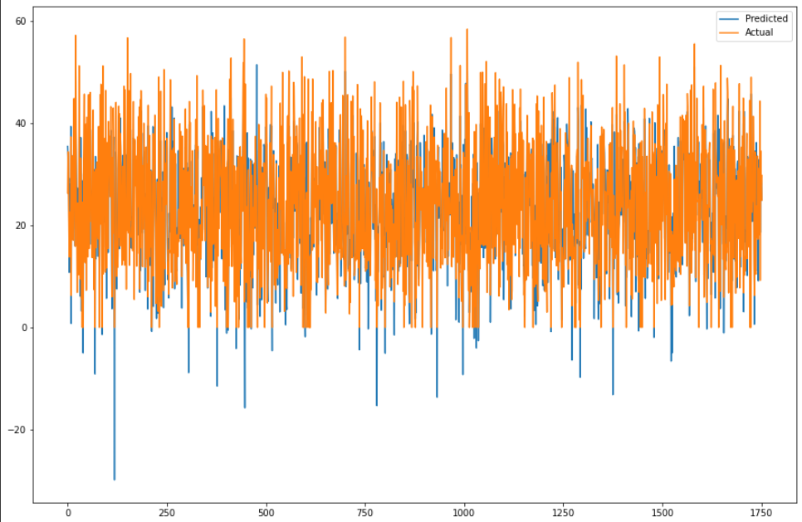
RIDGE REGRESSION
Train Set Results
Test Set Results

Slide 28
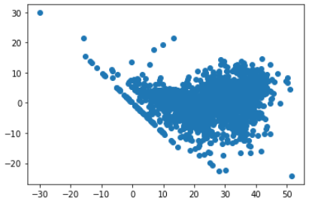
Heteroscedasticity
In this Regularized Ridge regression model we can see that model is able to capture most of the data/variance and hence data is less and randomly scattered and errors are not forming any pattern.
So, this model is suitable for the given dataset.

Slide 29
CHALLENGES
Large Dataset to handle.
Need to plot different Graphs for better analysis.
Outliers detection.
Treatment of Outliers.
Optimising the model for better accuracy.
Understanding the evaluation matrix.

Slide 30
CONCLUSION
‘Hour’ of a day holds the most important feature.
Bike rental count is mostly correlated with the time of the day as it is peak at 10 am morning and 8 pm at evening.
We observed that bike rental count is high during working days specially between 7am to 9am and 5pm to 7pm than non working day.
We see that people generally prefer to ride at moderate to high temperature, and also in light wind.
It is observed that highest number of rental bikes are counted in Autumn & Summer seasons & the lowest in winter season. We observed that the highest number of bike rentals on a normal day and the lowest on a snowy or rainy day. We observed that with increasing humidity, the number of bike rental counts decreases.

Slide 31
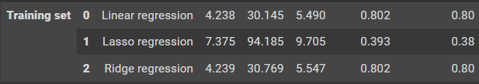
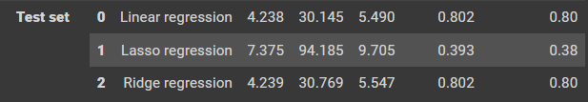
CONCLUSION CONT.
When we compare the root mean squared error and mean absolute error of all the models. We can see that we have very minimal error.So, ﬁnally this model is best for predicting the bike rental count on daily basis.
Training set Results
Test Set Results

Slide 32

Team GodSpeed☺

